Slide 1

The Promotion Process at SSOM:
An Overview
Kayhan Parsi, JD, PhD, HEC-C
Professor of Bioethics
Chair, Committee on
Academic Rank
and Tenure (CART)

Slide 2


Slide 3
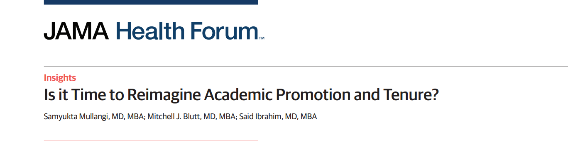
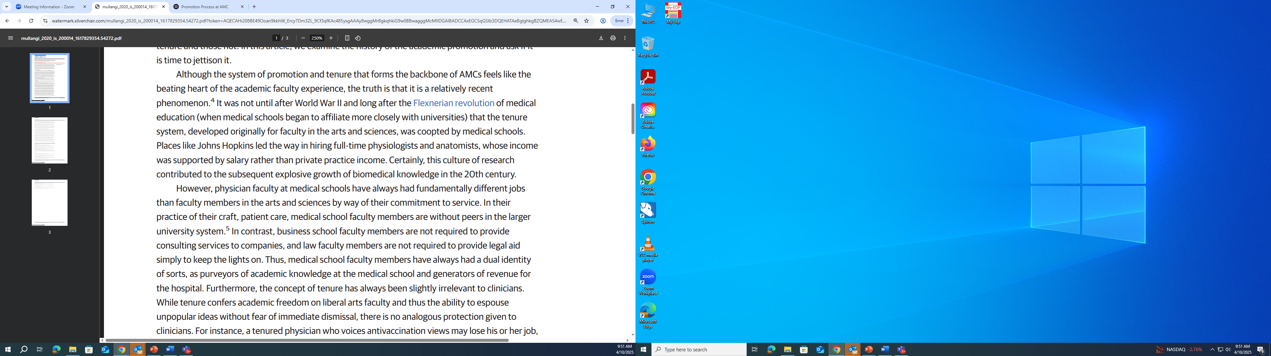

Slide 4
What’s the purpose of promotion?
To recognize excellence in:
clinical care
education
service
scholarly work
research

Slide 5
The Nuts and Bolts of Promotion

Slide 6

First things First
Know what Track you’re on!
Track is on your offer letter

Slide 7
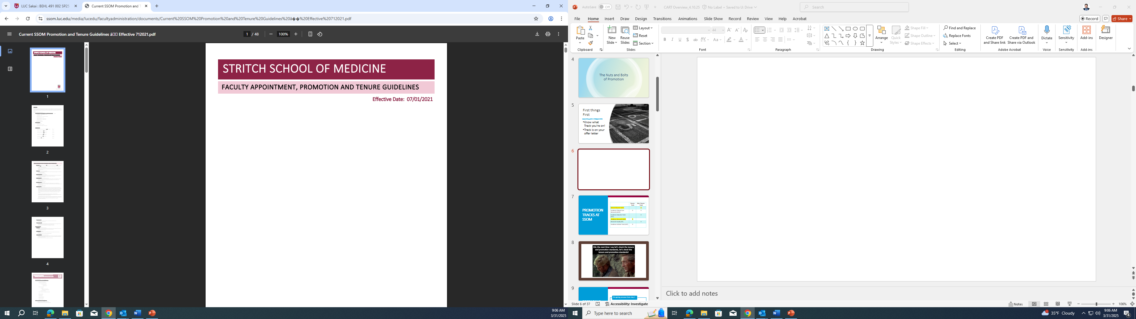
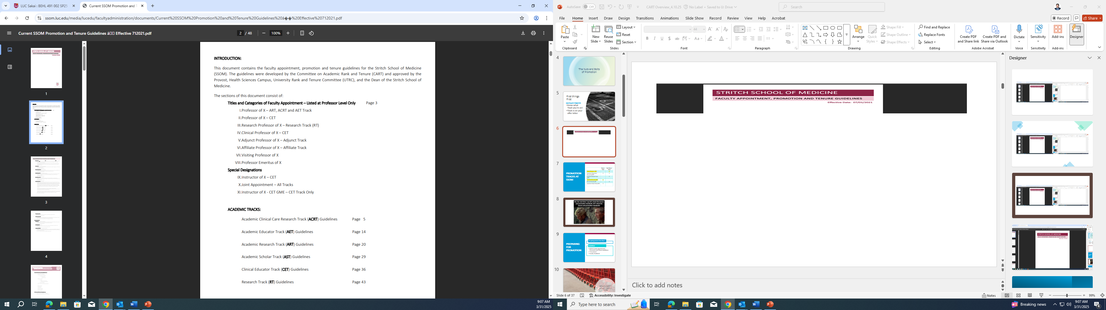

Slide 8
Promotion tracks at Ssom
 | Tenure-Track | Non-Tenure-Track
Clinical Educator (CET) |  | X
Academic Clinical Care Research (ACRT) | X | X
Academic Educator Track (AET) |  | X
Academic Research (ART) | X
Research Faculty (RF) |  | X
Academic Scholar Track (AST) | X

Slide 9


Slide 10
Preparing for promotion
On-going process from day 1
Guidelines
SSOM Faculty Appointment, Promotion and Tenure Guidelines
“FIS Criteria”
Faculty Handbook

Slide 11

What’s CART?
What’s URTC?

Slide 12

Preparing for promotion
Committees
  SSOM Committee on Academic Rank and Tenure (“CART”)
  Loyola University Rank and Tenure Committee (“URTC”)

Slide 13
What does CART do?
Review and recommend candidates for faculty appointments
Review and recommend faculty candidates for promotion and tenure
Composed of faculty from basic science and clinical departments
Most are full professors
Supported by SSOM Dean’s Office

Slide 14
What’s important in promotion decisions for clinical faculty?
Contributing to clinical activity
Educating students, residents, fellows, colleagues
Service within and outside of Loyola
Demonstrated commitment to scholarly activity

Slide 15
What is reviewed in the promotion process?
1. Scholarly Productivity
Peer-reviewed publications (quality, impact, consistency)
Grant funding (PI or Co-I roles, competitive sources)
Presentations at national/international conferences

Slide 16
What is reviewed in the promotion process?
2. Teaching & Mentorship
Classroom, lab, and clinical instruction
Development of educational materials or curricula
Mentoring students, residents, fellows, or junior faculty

Slide 17
What is reviewed in the promotion process?
3. Service to Institution & Profession
Committee involvement (departmental, institutional)
Peer review activities, editorial board service
Leadership roles in professional organizations

Slide 18
What is reviewed in the promotion process?
4. Reputation & Impact
Regional, national, or international recognition
Evidence of influence in field (citations, invited talks)
External letters of evaluation

Slide 19
What is reviewed in the promotion process?
5. Alignment with Mission & Values
Contributions to Jesuit values, diversity, and community engagement
Interdisciplinary collaboration

Slide 20
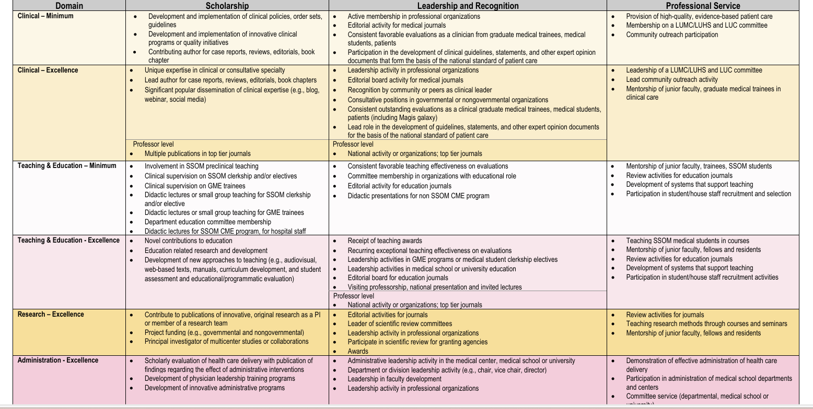

Slide 21
Some myths about “scholarly activity” for clinical faculty
Myth number 1: I need an R01
Myth number 2: I need to publish peer reviewed articles in top tier journals (e.g. JAMA, NEJM)
Myth number 3: I need to be first author on everything I publish

Slide 22

The truth about “scholarly activity” for clinical faculty
Everything counts (on some level):
  Abstracts
  Editorials
  Case Reports
  Book chapters
  Review articles
  Peer reviewed articles
  Developing innovative educational materials
  Quality improvement projects

Slide 23
What are the Academic Ranks?

Slide 24
Faculty ranks
Part-time SSOM Faculty have “Clinical” before the rank, e.g. “Clinical Associate Professor”
Professor
Associate Professor
Instructor
Assistant Professor

Slide 25
What Do I Need to Do to Submit my Application for Promotion?

Slide 26
Keeping track of everything
You probably do more than you think you do!
Lectures, conferences, committees, boards, projects, mentorship, …
Networking
Internal and external reviewers
Protecting your time

Slide 27
Keeping track of everything
Faculty Information System (FIS)
Confirm data
Update your CV regularly
Organize activities at different levels, e.g.
Service
To department
To the School
To University
To Community
External groups
Editorial boards
National organizations
Review CART’s CV template (SSOM)

Slide 28
Pre-promotion reviews
Demonstrating a positive trajectory
Annual reviews
Mid-promotion review
During third year after initial appointment
Meet with chair and identify reviewers
Review committee chaired by senior faculty member and 2 reviewers
Mid-promotion information is outlined in the P&T Guidelines under a faculty member’s track

Slide 29
Promotion and tenure process
KNOW WHEN YOU CAN NEXT APPLY!
5 years minimum in rank for non-tenure track
Look on your FIS profile under “Rank Date”
Early promotion possible for exceptional candidates (“outstanding merit/exceptional effort”)
SSOM: If at first you don’t succeed … you can try one more time (non-tenure, clinical faculty)

Slide 30
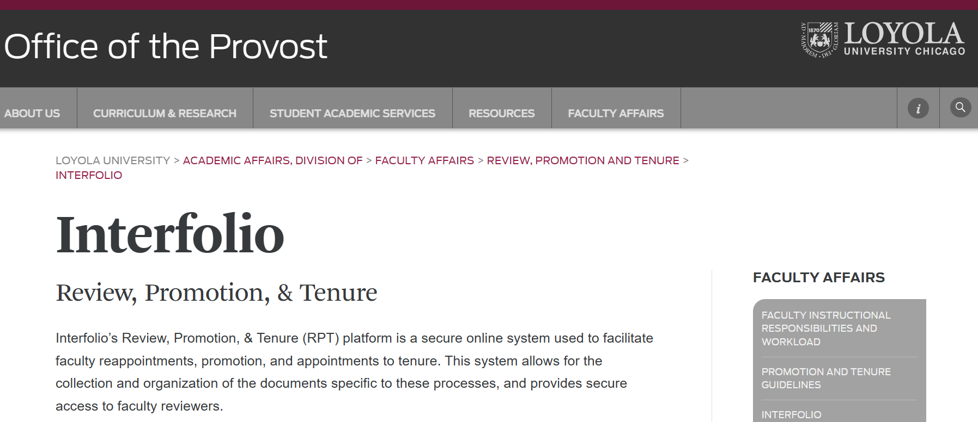

Slide 31
Interfolio Support
Effective January 21, 2025, the Interfolio institutional support email and phone number changed to:
+1 833-844-2118
interfolio-support@elsevier.com
For questions about candidate cases, adding/managing users, and academic unit templates, please contact: Interfolio@luc.edu
Interfolio cases will be created May 1st for candidates going up for promotion this fall
Candidates should be gathering their materials now

Slide 32
dossier
Cover Sheet
Letter of Recommendation from Department Chair
CV (in CART format for SSOM)
Personal Statement
Teaching Evaluations
Letters of Recommendation

Slide 33
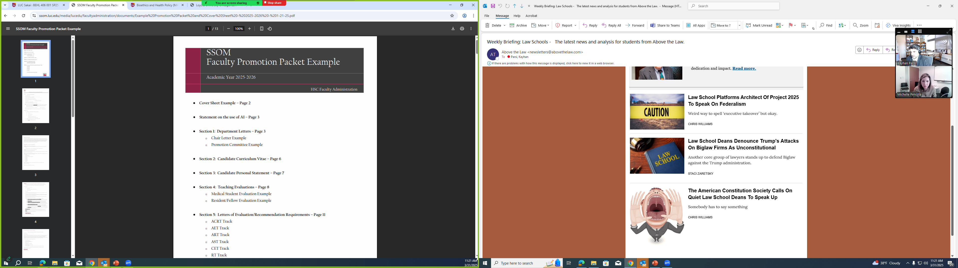
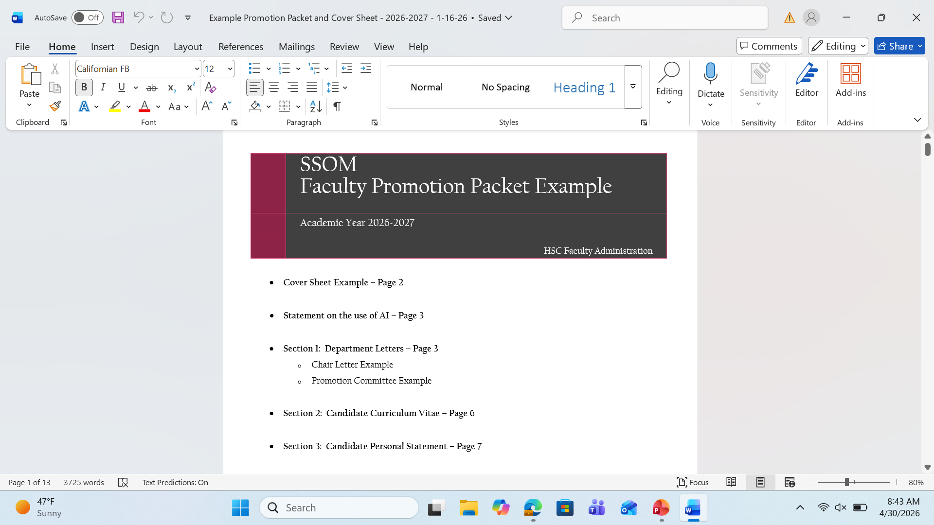
Promotion Packet Example:

Slide 34
Submitting your dossier
Notify chair of intent to apply (Spring)
Chair solicits review letters / evaluates candidates (Summer)
Dossier is “closed” and submitted to School P&T Committee (August 1st)
School P&T Committee reviews applications (Fall)
URTC reviews applications (December / January)
Candidates notified of final decision by Provost (March)
Dean reviews applications (Fall)
Candidate can withdraw from process at any time
SSOM CART allows NTT faculty to apply for the same rank up to two times
Year-long process

Slide 35
Moving from Associate to Full Professor (Clinical)
Criteria for Promotion:
At least meet the minimum requirements for a professor in clinical and teaching & education domains and professor level excellence in two domains.
A positive career trajectory including activity and/or recognition outside of SSOM and the Loyola University Health System (LUHS) on a national or international level is also expected
three external letters of recommendation/evaluation and one internal letter of recommendation/evaluation from full professors.

Slide 36
What Are Some Things I Should Look Out For?

Slide 37

Common pitfalls
No teaching evaluations / pattern of negative evaluations
Lack of scholarly activity
  Clinical research
  Educational innovation
  Quality improvement initiatives
External recognition
  Must get involved outside of Loyola

Slide 38

Final tips
Stay organized
  Review your FIS profile and CV
Get involved outside your department
  http://ssom.luc.edu/committees/
Seek out mentors
Look for collaboration on scholarly work
Solicit student and resident feedback
Check in on your progress
  Review guidelines annually

Slide 39

resources
SSOM Committee on Academic Rank and Tenure
  http://ssom.luc.edu/cart/
  Current SSOM Promotion and Tenure Guidelines
    FIS Criteria
    Tenure Tracking Chart & Summary Requirements Sheet
    CV and Bibliography Template
Faculty Handbook
  https://www.luc.edu/academicaffairs/facultyaffairs/facultyhandbook/
Notes:
Show CART website and links
Walk through Tenure Tracking Chart as a means of demonstrating ‘years in rank’

Slide 40
Questions?
SSOM’s Dean’s Office
SSOMDean@luc.edu
Kayhan Parsi, JD, PhD, HEC-C
Professor of Bioethics
Chair, CART
kparsi@luc.edu

